Slide 1
Construction site attendance application
Produced by:
LOL Co (Liana-Omid-Lana)

Slide 2
Problems
Solution
There’s no automated system to handle the workers’ attendance
Multi-steps Approval process includes - Attendance form printing out and filling in - Approval by Site Manager with sending papers by post to the office - final Approval by Project Manager All these issues lead to postpones in salary payment
A new system can handle multi-level management of attendance based on site and project
App provides tools for Approval at Site and Project manager levels

Slide 3
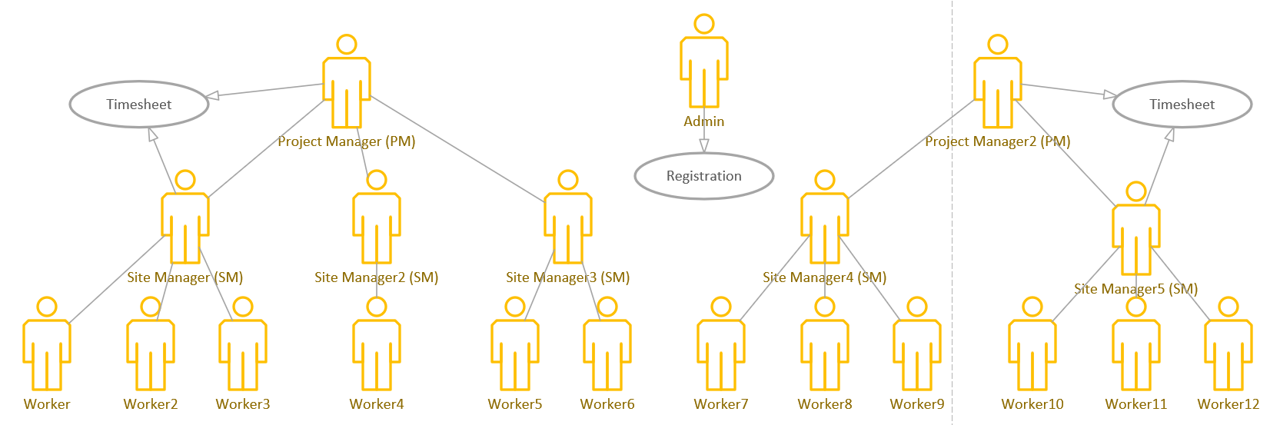
General Info
There are 3 types of users: Admin, Project Manager (PM), Site Manager (SM);
App consists of 3 main parts:
Login/main page
Registration tab
Timesheet tab

Slide 4
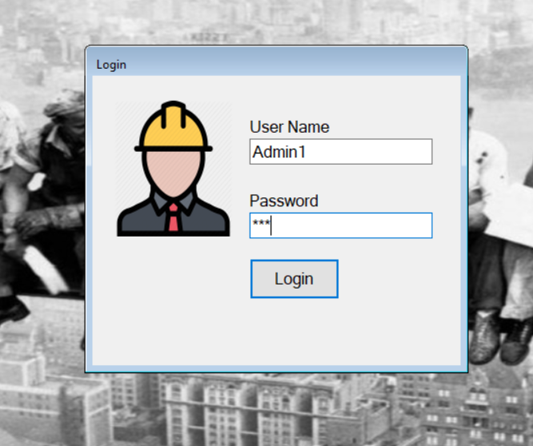
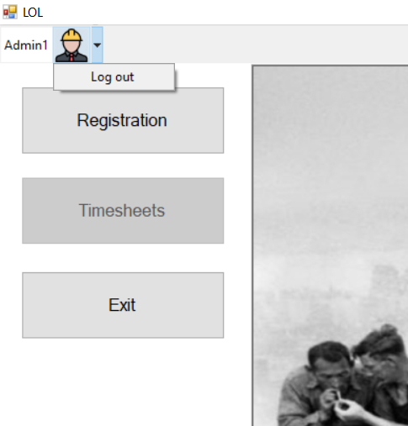
From a dream to reality
Main page
lol
Registration
Timesheet
Approval
Added Login go define the role
Timesheet & Approval were combined to one tab “Timesheet”
Exit

Slide 5
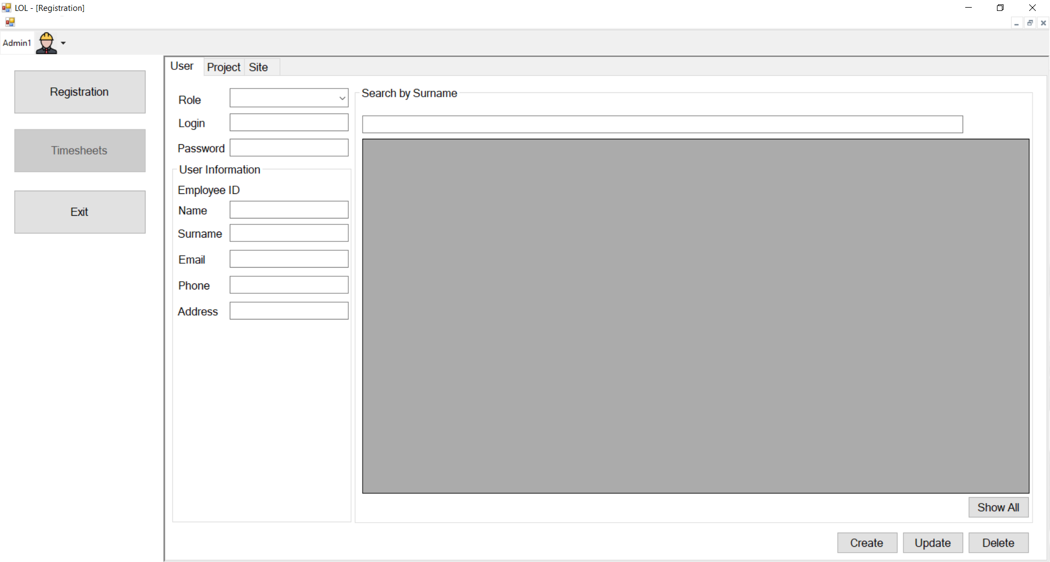
From a dream to reality
Registration- User
The Main menu is fixed on the left and visible from any section
Added a Search by Surname and function to view all users
Ability to Create, Update and Delete
lol
User and roles
Project
Site
Role
Password
Login
Surname
Name
Employee_ID
Email
Phone
Address

Slide 6
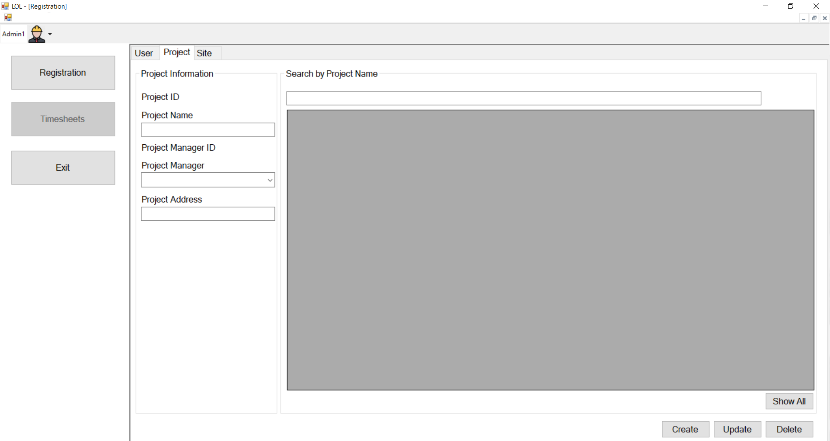
From a dream to reality
Registration- Project
The Main menu is fixed on the left and visible from any section
Added a Search by Project name and function to view all projects
Ability to Create, Update and Delete
lol
User and roles
Project
Site
Project name
Project address
Project manager
Working hours

Slide 7
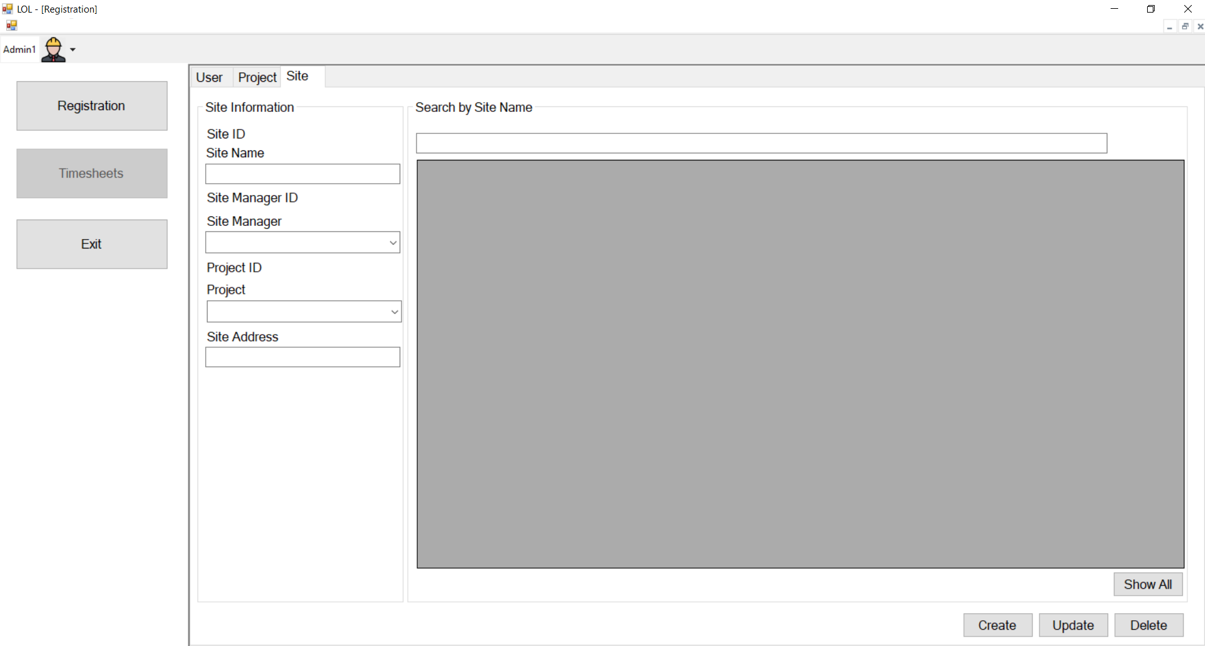
From a dream to reality
Registration- Site
The Main menu is fixed on the left and visible from any section
Added a Search by Site name and function to view all sites
Ability to Create, Update and Delete
lol
User and roles
Project
Site
Project
Site name
Site address
Site manager
Working hours

Slide 8

lol
Project
PM Approval
From a dream to reality
Site Name
Site Manager
Timesheet
Date
/ /
Worker Name | Worker ID | Working hours
Timesheet & Approval were combined to one tab “Timesheet”
Different roles have different abilities in the screen
Save
Approve
Cancel
Site Manager
lol
Daily Site Timesheet
Site Name
Date
/ /
Worker Name | Worker ID | Working hours
Save
Approve
Cancel

Slide 9
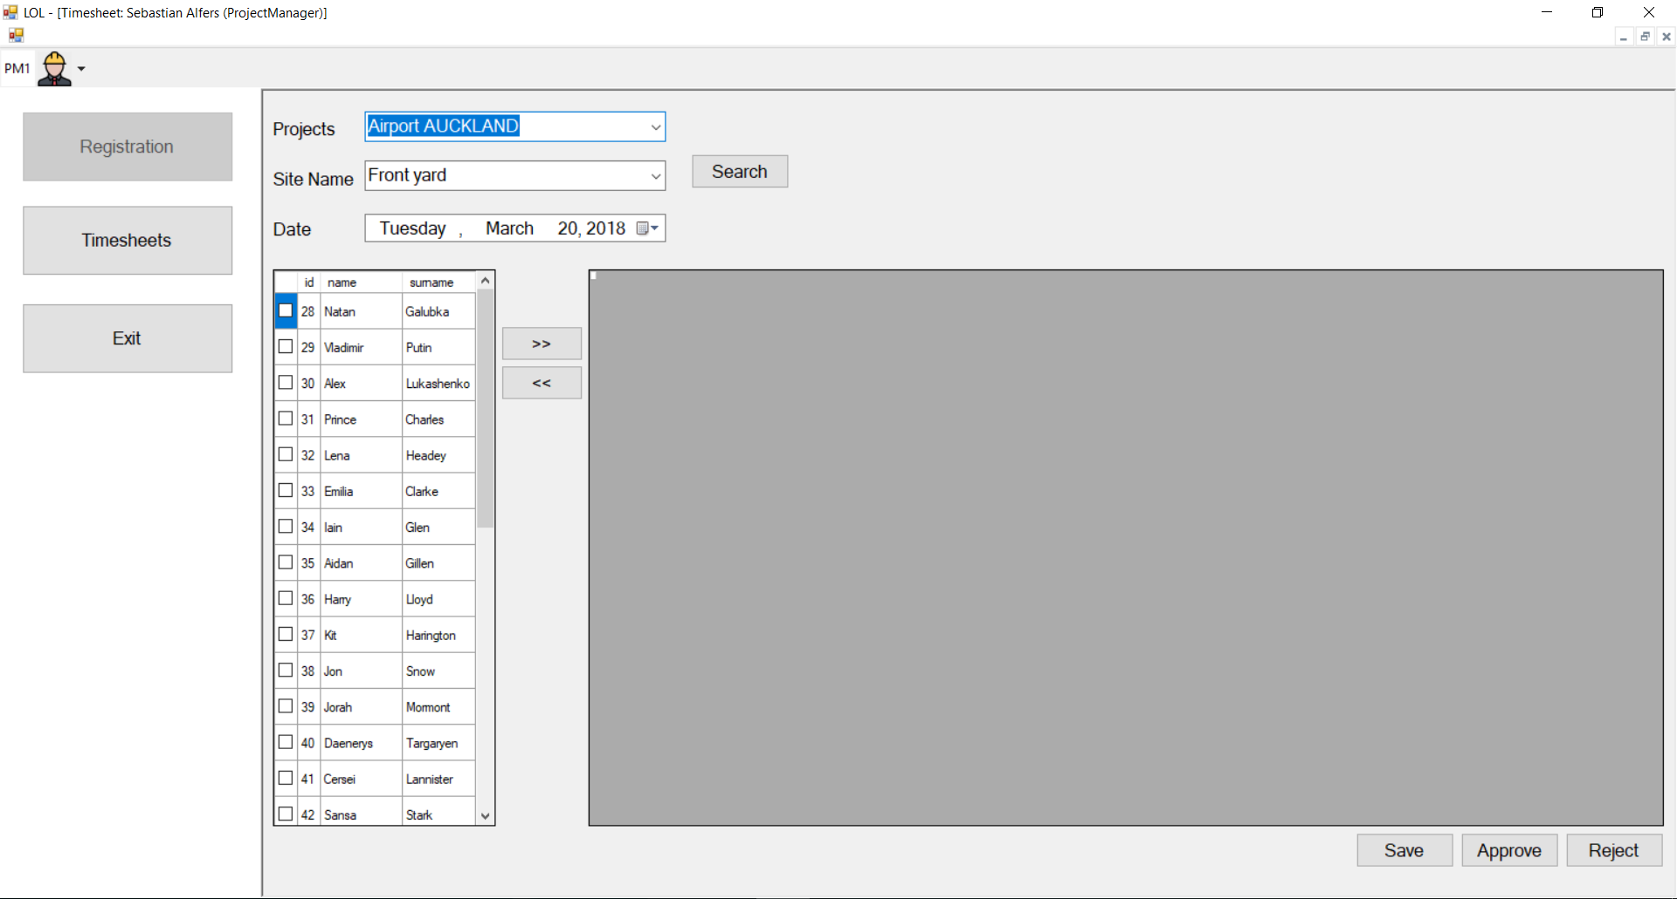
From a dream to reality
Timesheet
Ability to search by Project, Site and Date
Ability to add a worker to the timesheet and add, save, approve or reject his working hours
Ability to delete a worker from the timesheet

Slide 10


